Slide 1
Logistic Regression
Geoff Hulten

Slide 2
Overview of Logistic Regression
A linear model for classification and probability estimation.
Can be very effective when:
The problem is linearly separable
Or there are a lot of relevant features (10s - 100s of thousands can work)
You need something simple and efficient as a baseline
Real implementations can learn from a lot of data.
Logistic regression will generally not be the most accurate option.

Slide 3
Reminder: Components of Learning Algorithm
Model Structure
Loss Function
Optimization Method

Slide 4
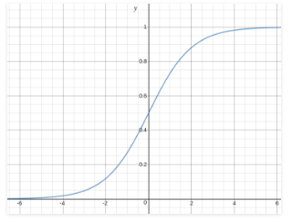

Structure of Logistic Regression
$y^{^}=sigmoid(w_{0}+ \sum_{i}^{n}{w_{i} ∗ x_{i})}$
$sigmoid\left(x\right)= \frac{1}{1+ e^{−x}}$
Threshold
Predict 0
Predict 1
Example:
W0 | W1 | W2
.25 | -1 | 1
X1 | X2
1 | 1
1 | 0
0 | 1
0 | 0

Slide 5

Not the Loss Function for Logistic Regression
$Loss\left(y^{^}, y\right)={(y^{^}−y)}^{2}$

Slide 6
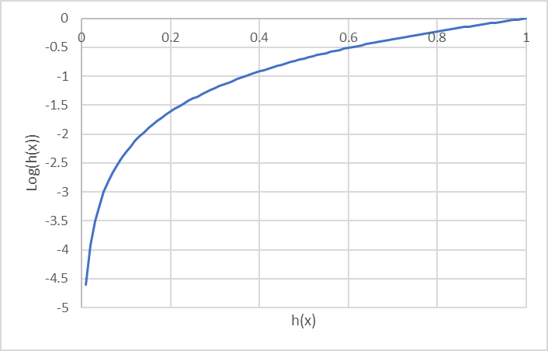
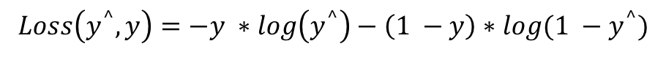

Loss function for Logistic Regression
$$Loss\left(y^{^},y\right)=−log\left(y^{^}\right) If y=1$$
$$Loss\left(y^{^},y\right)=−log\left(1 − y^{^}\right) If y=0$$
$$Loss\left(y^{^}, y\right)=−y ∗\log\left(y^{^}\right)−\left(1 −y\right)∗log(1 −y^{^})$$
y^ | y
.95 | 1
.1 | 0
.1 | 1
.95 | 0
$$Loss\left(testSet\right)=\frac{1}{n}\sum_{i}^{n}{Loss(y_{i}^{^},y_{i})}$$

Slide 7
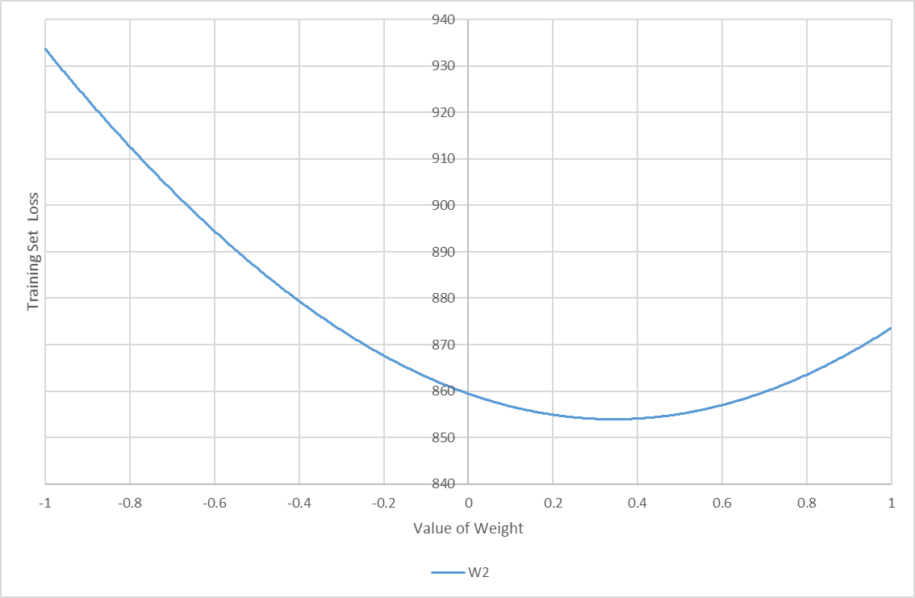
Review of Gradient Descent

Slide 8
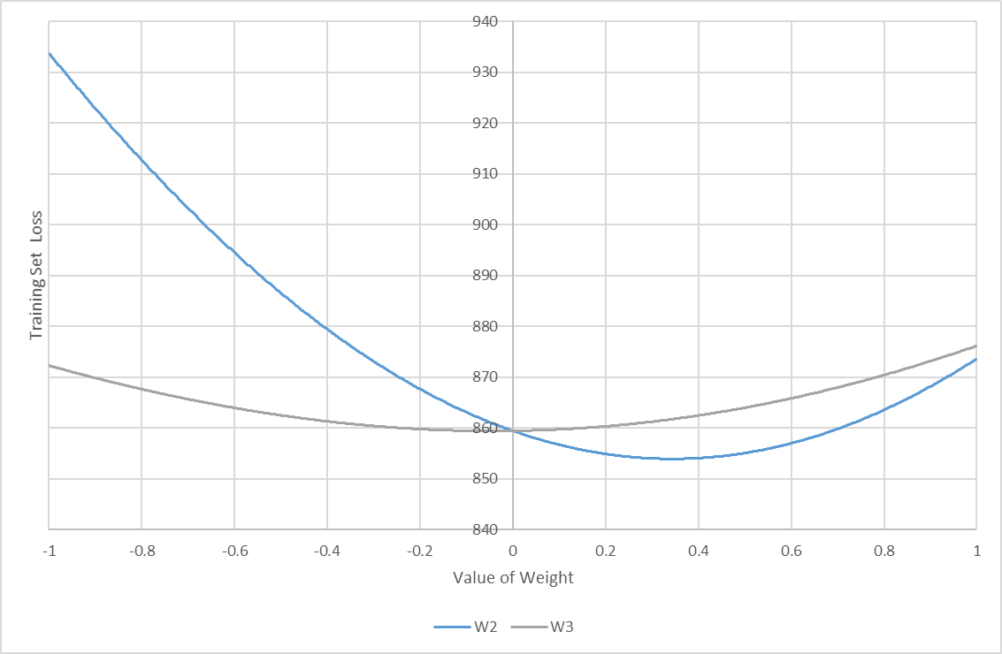
Gradient Descent With More Weights

Slide 9
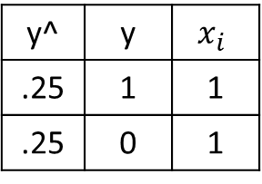
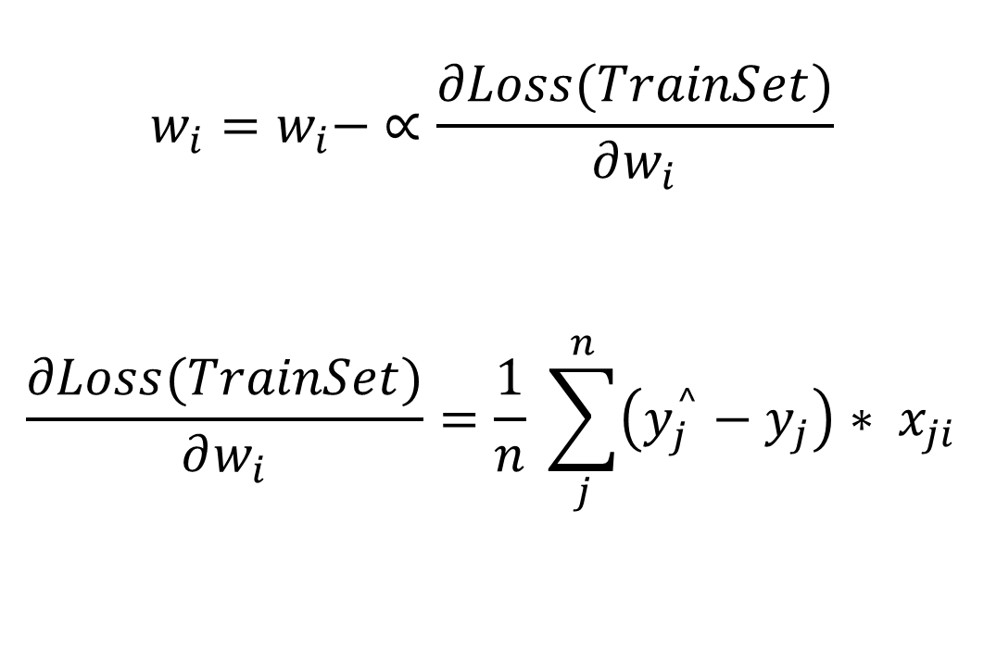

Fitting Parameters for Logistic Regression with Gradient Descent
$$w_{i}=w_{i}− ∝\frac{∂Loss(TrainSet)}{∂w_{i}}$$
$$\frac{∂Loss(TrainSet)}{∂w_{i}}=\frac{1}{n} \sum_{j}^{n}{\left(y_{j}^{^}−y_{j}\right)∗ x_{ji}}$$
y^ | y | $$x_{i}$$
.25 | 1 | 1
.25 | 0 | 1
Note: $x_{0}=1.0$ for all samples

Slide 10
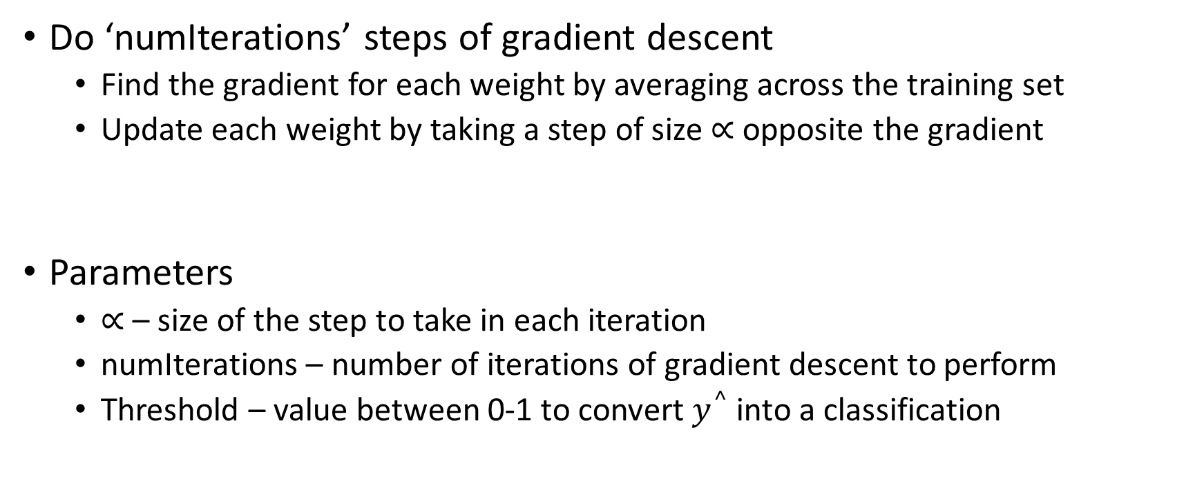
Logistic Regression Algorithm
Do ‘numIterations’ steps of gradient descent
Find the gradient for each weight by averaging across the training set
Update each weight by taking a step of size $∝$ opposite the gradient
Parameters
$∝$ – size of the step to take in each iteration
numIterations – number of iterations of gradient descent to perform
Threshold – value between 0-1 to convert $y^{^}$into a classification

